Slide 1
Monitoring
Bengaluru, Feb-2021, Saurav Anand

Slide 2
Table of contents
1
Format of PI Message
2
Message Monitor
3
Communication Channel Monitor
4
Performance Monitor
5
Java Proxy Runtime Monitor
6
Cache Monitor
7
Engine Status

Slide 3
Continued
8
Idoc Monitor
9
CPA Cache Monitor
10
Channel Independent Logs
11
Component Based Alerts
12
Transport Mechanism

Slide 4
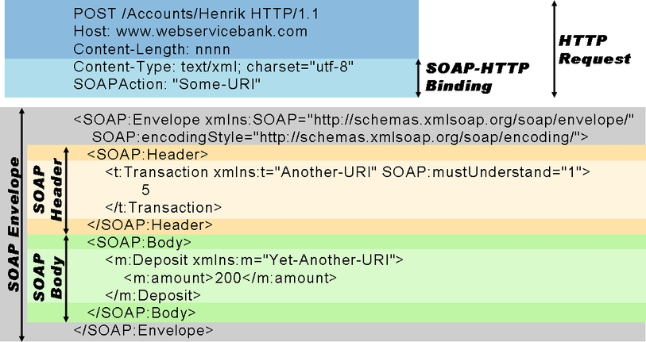
Format of PI Message
Example of basic SOAP document over HTTP

Slide 5
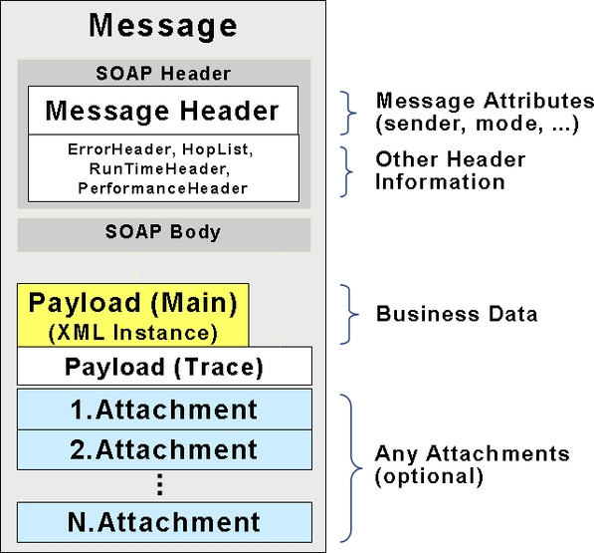
PI Message format: SOAP with attachments

Slide 6
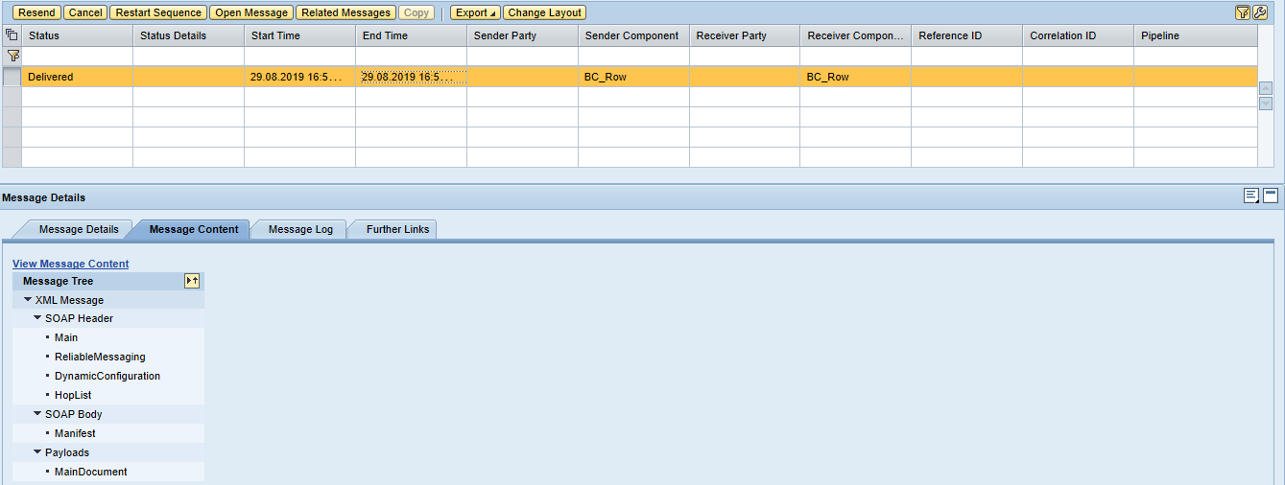
Viewing SOAP message parts within PI

Slide 7
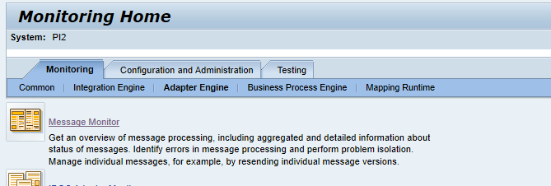
Message Monitor
Display message processing including aggregated and detailed information about status of messages, identify errors in message processing and perform problem isolation. Manage individual messages by, for example, resending individual message versions.
Open a browser and go to http://<host>:<port>/pimon to access the Process Integration tools. Then choose Monitoring >> Adapter Engine >> Message Monitor.
Click on the Message Monitor
In the message monitor, you can access the message overview or search for persisted or archived messages as described below.

Slide 8
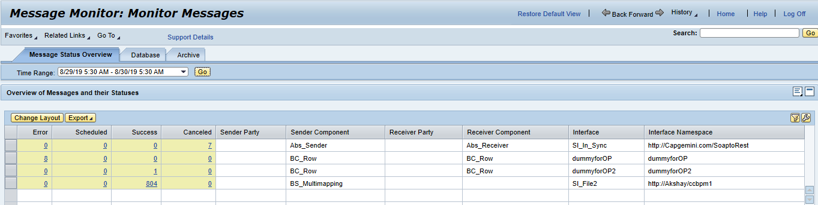

Slide 9
Message Status Overview
Message Status Overview will allow you to get a quick overview of the entire message flows sorted by interfaces and status. Overview of Messages and their Statuses shows: 1. Error 2. Scheduled 3. Success 4. Cancelled Run the transaction for each component is the PI system every hour in the production system. The transaction should be run once a day in the development and testing systems. (It vary depends upon the project requirements)

Slide 10
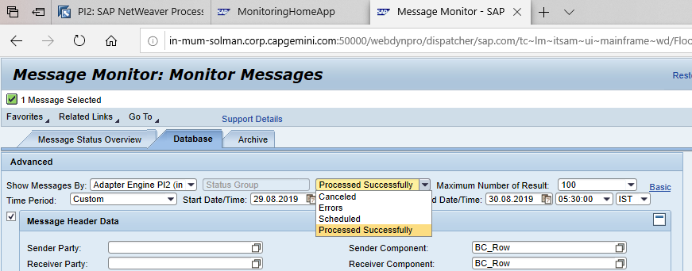
Database
Set the time option to cover the last hour for the production system and last day for other systems and access the information by pressing display.
Analyze any errors or cancelled with errors and attempt to fix any problems.
Run the monitor regularly in the production system. The transaction should be run once a day in the development and testing systems (It vary according to project requirements).

Slide 11
The Adapter Engine’s Messaging System (MS) receives the message, processes it and forwards it to the receiver. While the MS processes the message, it passes several statuses:
● TO_BE_DELIVERED: The state of message when it is initially handed over to the Messaging System.
● DELIVERING: The state of message when it has popped out of the MS queuing system and is in the process of being transmitted across the wire or delivered to an application.
● DELIVERED: The state of message when it has successfully reached its intended recipient.
● SYSTEM ERROR: The state of issues with the messages that are flowing through the PI side that can be stuck for several reasons.
● HOLDING: The state of an EOIO message that cannot be delivered until its predecessors have been delivered.
● WAITING: The state of a message that has been attempted to be sent at least once, failed, and is currently waiting for another attempt.

Slide 12
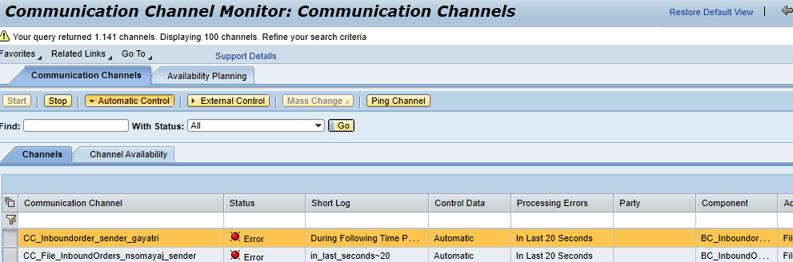
Communication Channel Monitor
Display the status of the communication channels and the corresponding adapters to get detailed and up-to-date runtime information about individual communication channels. Communication Channel Monitor could be accessed in one of the following ways
Open a browser and go http://<host>:<port>/pimon to access the Process Integration tools. Then choose Monitoring >> Adapter Engine >> Communication Channel Monitor.
Click on the Communication Channel Monitor.
The components of the PI system should be analyzed regular basis in the production system. The transaction should be run once a day in the development and testing systems.

Slide 13
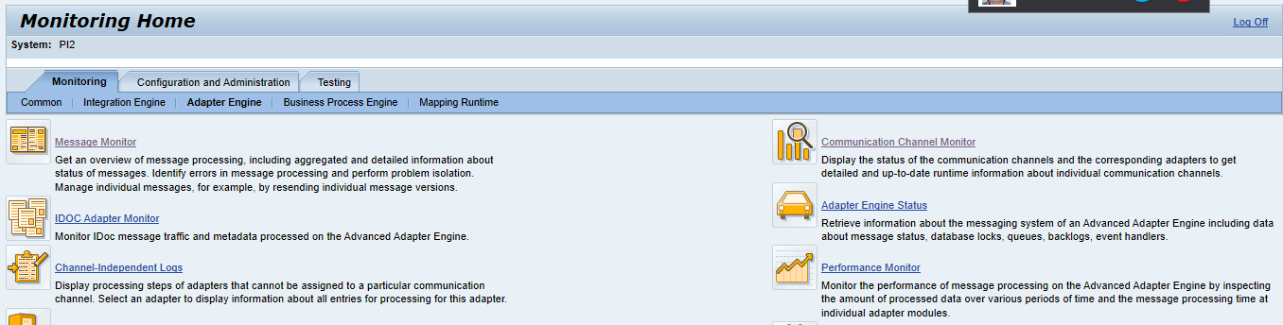
Performance Monitor
Monitor the performance of message processing on the Advanced Adapter Engine by inspecting the amount of processed data over various periods of time and the message processing time at individual adapter modules.
Performance Monitor could be accessed in one of the following ways:
Open a browser and go to http://<host>:<port>/pimon to access the Process Integration tools. Then choose Monitoring >> Adapter Engine >> Performance Monitor.
Click on the Performance Monitor

Slide 14
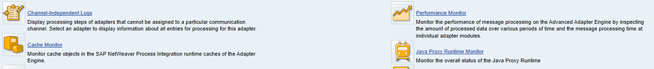
Java Proxy Run Time Monitor
Monitor the overall status of the Java Proxy Run time.
Java Proxy Run Time Monitor could be accessed in one of the following ways:
Open a browser and go to http://<host>:<port>/pimon to access the Process Integration tools. Then choose Monitoring >> Adapter Engine >> Java Proxy Run time Monitor.
Click on the Java Proxy Run time Monitor

Slide 15
Cache Monitor
Monitor cache objects in the SAP Net Weaver Process Integration run time caches of the Adapter Engine.
Cache Monitor could be accessed in one of the following ways:
Open a browser and go to http://<host>:<port>/pimon to access the Process Integration tools. Then choose Monitoring >> Adapter Engine >> Cache Monitor.
Click on the Cache Monitor

Slide 16
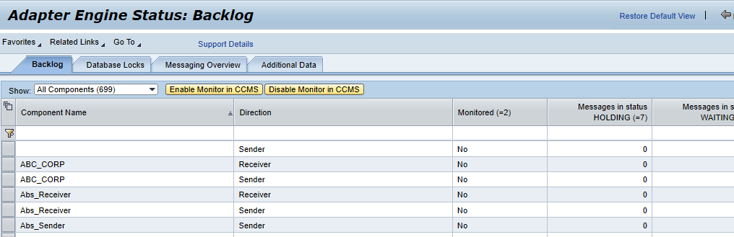
Engine Status
Retrieve information about the messaging system of an Advanced Adapter Engine including data about message status, database locks, queues, backlogs, event handlers.
Engine Status could be accessed in one of the following ways:
Open a browser and go to http://<host>:<port>/pimon to access the Process Integration tools. Then choose Monitoring >> Adapter Engine >> Engine Status.
Click on Engine Status

Slide 17
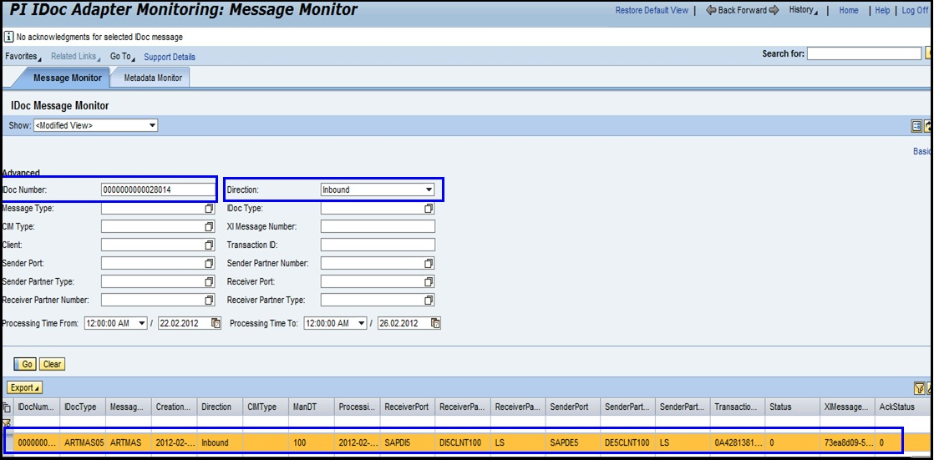
IDOC Monitor
Monitor IDoc message traffic and meta data processed on the Advanced Adapter Engine.
IDOC Monitor could be accessed in one of the following ways:
Open a browser and go to http://<host>:<port>/pimon to access the Process Integration tools. Then choose Monitoring >> Adapter Engine >> IDOC Monitor
Click on IDOC Monitor

Slide 18
Procedure
Choose the Message Monitor tab.
Choose one of the following search modes:
>> To perform a quick search, simply select one of the options in the Show drop-down menu.
>> In basic search mode, you can enter the number of the IDoc message in the Find field, and specify the message direction and the time period.
>> In advanced search mode, you can enter parameters of the IDoc or XI message as well as the start and end of the search period.

Slide 19
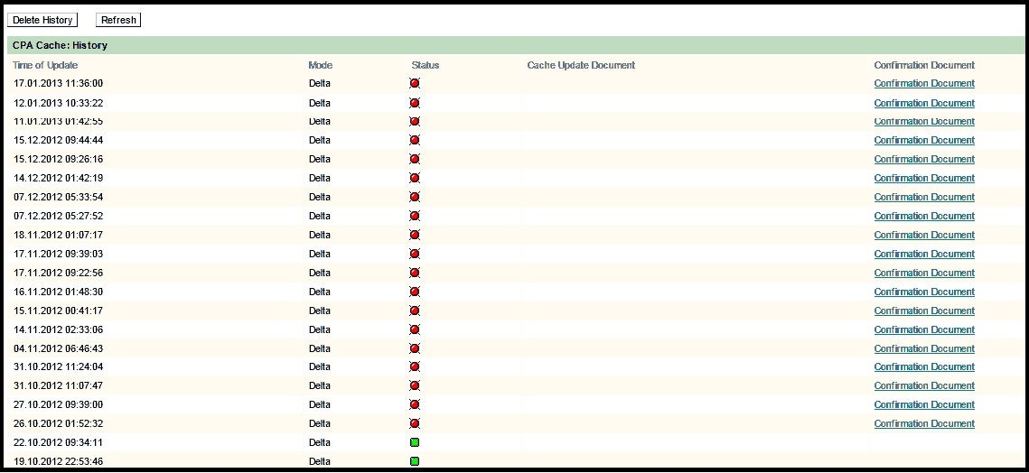
CPA Cache History
CPA Cache History could be accessed in one of the following ways:
Open a browser and go to http://<host>:<port>/pimon to access the Process Integration tools. Then choose Monitoring >> Adapter Engine >> Channel Independent Log
Click on the CPA cache history.

Slide 20
Channel Independent Log
Display processing steps of adapters that cannot be assigned to a particular communication channel. Select an adapter to display information about all entries for processing for this adapter.
Channel Independent Log could be accessed in one of the following ways:
Open a browser and go to http://<host>:<port>/pimon to access the Process Integration tools. Then choose Monitoring >> Adapter Engine >> Channel Independent Log
Click on the Channel Independent Log

Slide 21
Component based alerts
Component-Based Message Alerting (CBMA) is the new way of sending alerts on SAP PI (either single or double stack) without the use of any additional components. CBMA is made of three componets:
a) Central configuration for creating alerts - alerts can be created in Integration Directory or in Netweaver Administrator
b) Alert Engine - which is supposed to evaluate rules and create alerts
c) Alert receivers (consumers) - components which can receive alerts from the Alert Engine

Slide 22
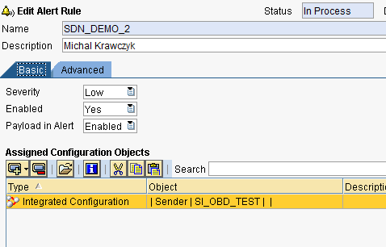
Steps….
Step 1 - Create alerts in Integration Directory
We need to specify a new alert rule and assign PI objects to that rule as shown in Figure below
Specify alert severity, if the alert rule is enabled (or disabled) and if the payload should be included in the alert message.

Slide 23
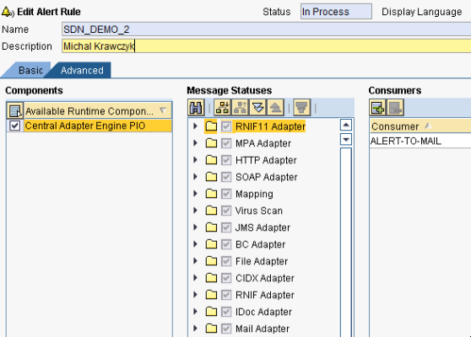
Step 2 - Specify which types of alerts should be included in the alert rule like for example all alerts from a single adapter type (file or jdbc), etc. You also need to specify an alert receiver (consumer), which in this case will be an e-mail service.

Slide 24
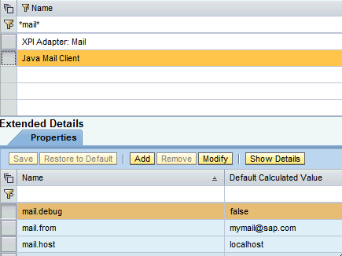
Step 3 - Configure alert consumer for e-mail notifications. There is a new JavaMail Client Service which needs to be configured on the in order to be able to consume alert messages on the JAVA stack

Slide 25
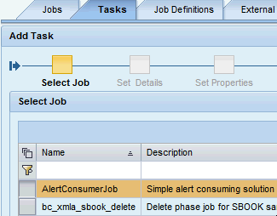
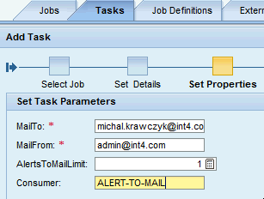


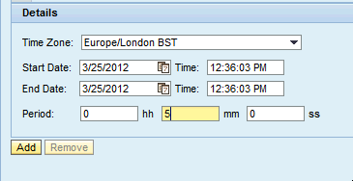
Step 4 - The last thing we need to do is to schedule a job that will be running and creating alert notifications from the generated alerts.
Open SAP Netweaver admin: Operations -> Jobs -> Java Scheduler -> Job Definitions

Slide 26
Transport Mechanism
You use this procedure to transport PI objects (systems, parties, integration flows, referenced channels, and value mapping groups) or integration flows with their referenced entities (parties, systems, and referenced channels used in the integration flow) from a development to a test environment or from a test to a production environment.
Types of Transport Mechanism
File transport (.tpz file): The File transport type allows you to export the objects from a source system to a locally stored .tpz file and import the file into a target system.
CTS+ : If you want to export objects from a source system and easily import them to multiple target systems in a landscape, you can choose the CTS+ transport type.

